Slide 1


Loops, Pandas, and more Stuff
Wake Forest
School of Business
_______
Day 3 Bootcamp

Slide 2
Agenda
Recap of Day 1 & 2
Variables
Lists
Dictionaries
Loops
For
While
More Pandas
Dataframe attributes & data types
Exploring data
Filtering
Nulls
Dates
Itterrows
Recap
"Pandas dataframes are a game-changer for data analysis in Python. They provide a flexible and intuitive way to organize, manipulate, and analyze data. With its powerful capabilities, pandas allows us to efficiently tackle complex data problems and extract valuable insights. It's an essential tool for any data scientist or analyst working with Python." - Jeff Hammerbacher

Slide 3
Basic Python Syntax Rules
Variable names in Python must follow certain rules:
They can contain letters (a-z, A-Z), digits (0-9), and underscores (_).
They must start with a letter or an underscore. They cannot start with a digit.
They are case-sensitive, so "myVar" and "myvar" are considered different variables.
Common naming conventions include:
Using lowercase letters for variable names (e.g., my_variable).
Using underscores to separate words in variable names (e.g., total_marks).
Using uppercase letters for constants (e.g., PI).
Python has reserved words – cannot/shouldnot be used as variable names.
Examples of reserved words include if, for, while, def, class, import, and many others.

Slide 4
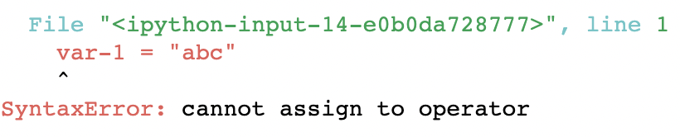
Python Variable Naming
Rules for Python variables:
A variable name must start with a letter or the underscore character
Valid examples: A_var, _Var1, myVar1
A variable name cannot start with a number
In-valid: 9_abc
A variable name can only contain alpha-numeric characters and underscores (A-z, 0-9, and _ )
In-valid: var-1
Variable names are case-sensitive
Age, age, AGE, are three different variables.
var-1 = "abc"

Slide 5
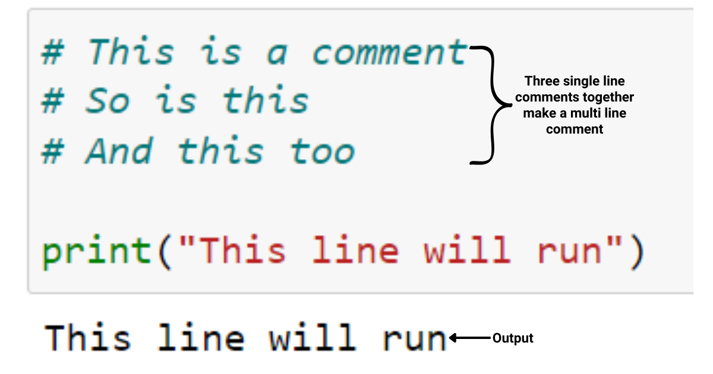
Python Comments
Single Line Comments “#”
Comments are essential for documenting code and improving its readability.
Use the hash symbol (#) to add comments in Python.
Anything after the # is considered a comment and is not executed.
Correct syntax example:
# this is a sample comment
Multi-Line Comments are enclosed within triple quotes (''' or """).
Multi-line strings can span multiple lines without the need for explicit line continuation.
Correct syntax example:
message = '''This is a
multi-line
string.'''

Slide 6
Case Sensitivity
Python is case-sensitive, meaning that variables and function names must match case exactly.
Correct syntax example:
count = 10
Count = 20 print(count) # Output: 10
print(Count) # Output: 20
Preferred naming convention :
Using lowercase letters for variable names (e.g., my_variable).
Using underscores to separate words in variable names (e.g., total_marks).
Using uppercase letters for constants (e.g., PI).

Slide 7
Integers vs Floats
Integers are whole numbers, without any decimal points.
They can be positive, negative, or zero.
Examples of integers: -10, 0, 42, 1000.
Floats represent numbers with decimal points.
They can be positive, negative, or zero.
Examples of floats: -3.14, 2.718, 0.5, 10.0.
Differences between int and float
Integers are precise and can represent exact values.
Floats have decimal precision and can represent fractional or approximate values.
Both int and float support arithmetic operations like addition, subtraction, multiplication, and division.
Operations involving both int and float will result in a float.
Type Conversion between int and float
int() can be used to convert a float to an integer (e.g., int(3.14) returns 3).
float() can be used to convert an integer to a float (e.g., float(10) returns 10.0).

Slide 8
Strings
String Data Type
Strings represent sequences of characters enclosed in single quotes (' ') or double quotes (" ").
Examples of strings: 'Hello', "Python", '42', "OpenAI".
String Concatenation
Strings can be concatenated (joined together) using the concatenation operator (+).
Example: 'Hello' + 'World' results in the string 'HelloWorld’.
String Length and Methods
len() function finds the length (number of characters) of a string.
Example: len('Hello') returns 5.
Strings have built-in methods for operations like converting case, replacing characters, splitting, etc.
upper(), lower(), strip(), split(), replace(), and many more

Slide 9
Some new-ish stuff
Line Continuation
Sometimes, code lines become too long to fit within the recommended line length (80 characters). In such cases, line continuation can be used.
Use a backslash (“\”) at the end of a line to continue the code on the next line.
Correct syntax example:
total = 10 + \
5 + \
3
Be cautious when doing this stunt!

Slide 10
Operations
Operations | Description
A + B | Add A and B together
A - B | Subtract A from B
A * B | Multiply A by B
A / B | Divide A by B
A // B | Floor divide A by B, dropping and remainder
A ** B | A raised to the power of B
A & B | True if both A AND B are True;
A | B | True if either A OR B is True;
Comparison Operations | Description
A == B | True if A equals B else False
A != B | True if A does not equal B else False
A <= B, A < B | True if A is less than or equal to B, or less than B
A >= B, A > B | True if A is greater than or equal to B, or greater than B

Slide 11

Indentation: Spaces over Tabs
Indentation
Python uses indentation to define blocks of code instead of curly braces or keywords like "end" in other languages.
Indentation is typically four spaces or a tab.
Correct syntax example:
if x > 5:
print("x is greater than 5")
else:
print("x is not greater than 5")
JUST BE CONSISENT!!!

Slide 12

Open: Day 3.1 Review
5 Minutes

Slide 13
Lists
Lists: ordered collections of items enclosed in square brackets []
Examples of creating and accessing lists:
my_list = [1, 2, 3, 4, 5]
print(my_list[0]) # Output: 1
Methods
append() Adds an item to the end of the list.
Syntax: list_name.append(item)
Example: my_list = [1, 2, 3]
my_list.append(4) # [1, 2, 3, 4]
remove() removes the first occurrence of a specified item from the list.
Syntax: list_name.remove(item)
Example: my_list = [1, 2, 3, 4, 3]
my_list.remove(3) # [1, 2, 4, 3]
len() Returns the number of items in the list.
Syntax: len(list_name)
Example: my_list = [1, 2, 3, 4, 5]
length = len(my_list) # 5
ex_list =
Item 1 | Item 2 | Item 3 | … | Item N

Slide 14
Dictionaries
Dictionaries : unordered collections of key-value pairs enclosed in curly braces {}
Example:
my_dict = {"name": "John", "age": 30, "city": "New York"}
print(my_dict["name"]) # Output: John
Dictionary methods like keys(), values(), and items()
keys() Returns the keys of the dictionary.
Example: my_dict = {"name": "John", "age": 30, "city": "New York"}
keys = my_dict.keys() # ["name", "age", "city"]
items() Returns the key-value pairs of the dictionary as tuples.
Example: my_dict = {"name": "John", "age": 30, "city": "New York"}
items = my_dict.items() # [("name", "John"), ("age", 30), ("city", "New York")]
values() Returns the values of the dictionary.
Example: my_dict = {"name": "John", "age": 30, "city": "New York"}
values = my_dict.values() # ["John", 30, "New York"]

Slide 15

Pandas
Pandas is the KEY data manipulation and analysis library in Python.
Series: One-dimensional labeled array capable of holding any data type.
DataFrame: Two-dimensional labeled data structure with columns of potentially different data types.
Importing Pandas: import pandas as pd
Reading Data with Pandas:
pd.read_csv(): Reads data from a CSV file into a DataFrame.
Other file formats supported by Pandas: Excel, JSON, SQL, etc.
Exploring Data with Pandas:
Basic DataFrame operations: head(), tail(), shape, columns, etc.
Examining the data: info(), describe(), dtypes, etc.
Filtering rows based on conditions.
Summary Statistics and Data Exploration:
Descriptive statistics with describe().
Unique values and value counts with value_counts().

Slide 16
Open: Day 3.2 Review
10 Minutes

Slide 17
Loops in Python
A way to repeat a block of code multiple times
Loops are essential for automating repetitive tasks and iterating over collections (lists, dictionaries, data frames) .
While loop:
For loop: is used for iterating over a sequence (such as a list, string, or range)
Difference between while and for loops
Exercise: Write a program using a loop to print numbers from 1 to 10

Slide 18
Loops in Python
Getting Loopy
“Looping” also known as “cycling” or “iterating” is nothing more than automating a multi-step process by organizing sequences of actions by grouping the parts that need to be repeated.
“for” loops - execute for a prescribed number of times, as controlled by a counter or an index, incremented at each iteration cycle.
“while” loops – execute are until a condition is met. The condition is tested at the start or the end of the loop construct.
Notice the indentation.
for x in sequence:
# do something until reach end of sequence
Notice the indentation.
while (condition is not met):
#do something until condition is met

Slide 19
Indentation
Quite important!
Indentation refers to the spaces at the beginning of a code line.
Where in other programming languages the indentation in code is for readability only. Python uses indentation to indicate a block of code.
if 5 > 2: print("Five is greater than two!")
Spaces are the preferred indentation method. Tabs should be used solely to remain consistent with code that is already indented with tabs. Python 3 disallows mixing the use of tabs and spaces for indentation.
Notice the indentation.
https://www.youtube.com/watch?v=SsoOG6ZeyUI

Slide 20
Loops in Python
FOR loop
Typically, we operate on a SEQUENCE or A LIST
SEQUENCE ex. Range(6) is simply a list of integers 0, 1, 2, 3, 4, 5
OR in a LIST like [“red”, “green”, “blue”]
for i in range(5):
print(i)
[1] 0
[1] 1
[1] 2
[1] 3
[1] 4
for i in [“red”, “green”, “blue”] :
print(i)
[1] "red"
[1] "green"
[1] "blue”

Slide 21
Loops in Python
Nesting Loops
Just put a loop within a loop
for i in [1,2,3]:
for c in [“red", "green", "blue”]:
print(“{0} {1}”.format(i,c))
[1] "1 red"
[1] "1 green"
[1] "1 blue"
[1] "2 red"
[1] "2 green"
[1] "2 blue"
[1] "3 red"
[1] "3 green"
[1] "3 blue"
Loops specifically FOR loops are critical for automating our analysis.
Why do it multiple times if all I need do is wrapper my calls in a loop and iterate

Slide 22
While we are at it…
While loops – Try to avoid.
Unless you are programing an algorithm, solver, or a chatbot.
While loops are not something often seen in data science.
Why? They are prone to error and not completing…
Let's check them out anyway!
while (True):
# statement
# DO UNTIL FALSE!!!
The ”while” loop will continue to cycle until the test expression is met, what if it is never met? It’s going to continue to cycle until you kill the process.

Slide 23
Open: Day 3.3 For Loops
10 Minutes

Slide 24
Open: Day 3.4 While Loops
10 Minutes

Slide 25

Dive into Pandas
"Without data, you're just another person with an opinion.” – Edward Deming renowned statistician

Slide 26
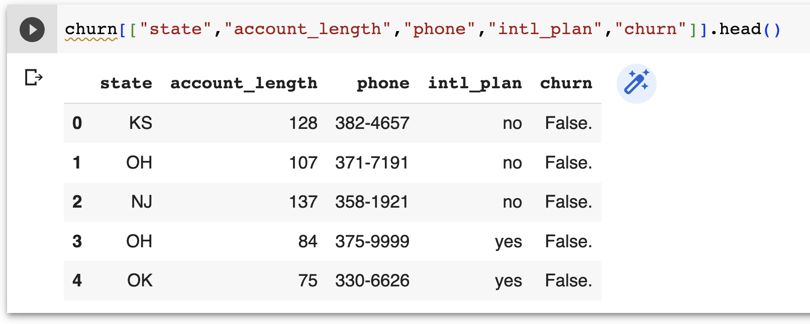
Pandas
Making data frames cool again.
Pandas is an open-source library in Python used for data manipulation, exploratory analysis, visualization and much more..
Developed by Wes McKinney in 2008
Handles different data types (numerical, categorical, text, datetime, complex)
Variety of functions for analysis
Flexible shaping, reshaping and pivoting of datasets
High performance merging and joining of data
Time Series functionality

Slide 27
Pandas
Data Types
To add to our confusion, Pandas has their own “data types” which are essentially extensions of Python types and NumPy data types. The table below details these.
Converting between data types in Pandas is straight forward
Use astype() to force an appropriate dtype
Use pandas' functions such as to_numeric() or to_datetime()
Pandas dtype | Python type | Usage
object | str or mixed | Text or mixed numeric and non-numeric values
int64 | int | Integer numbers
float64 | float | Floating point numbers
bool | bool | True/False values
datetime64 | datetime | Date and time values
timedelta[ns] | NA | Differences between two datetimes
category | NA | Finite list of text values

Slide 28
Pandas
Properties
df.shape – returns the number of rows and columns of a data frame
You can reference df.shape[0] to return number of records.
df.columns – returns a “list” of columns
You can change column names by updating the list OR using the rename function
df.dtypes – returns a Series with the data type of each column
Use this to check the assigned data types
df.index – returns the range index object, details on the index, not super useful.
df.info() – returns all the above and more about the dataframe.
Use this to get details about your data frame.

Slide 29
Pandas
What is a Series?
Each column in a data frame is a “series”
Think of it as a single column DataFrame
newSeries = df[“Column1”]
Series
Index | Column1 | Column2 | ColumnN
0
1
…
N
Index | Column1
0
1
…
N
=
> type(df[”Column1"])
% pandas.core.series.Series
https://pandas.pydata.org/pandas-docs/stable/reference/api/pandas.Series.html

Slide 30
Pandas
How do I “select specific columns”
Select specific “columns” = [[ ]] – “bracket bracket”
newDataFrame = df[[ ”Column1”, “Column3”]]
DataFrame
Index | Column1 | Column2 | ColumnN
0
1
…
N
Index | Column1 | Column3
0
1
…
N
=
> type(df[[”Column1”]])
% pandas.core.frame.DataFrame
https://pandas.pydata.org/pandas-docs/stable/reference/api/pandas.DataFframe.html

Slide 31
Pandas
How do I “select specific rows?” ~ DataFrame Filtering
Select specific “rows” = either df[df..] or df.loc[df..]
queryResult = df[df[“Column1] == “value”]
queryResult = df.loc[df[“Column1] == “value”]
DataFrame
Index | Column1 | Column2 | ColumnN
0
1
…
N
Index | Column1 | Column3
0
1
…
M
=
https://towardsdatascience.com/filtering-data-frames-in-pandas-b570b1f834b9

Slide 32
Pandas
Conditional Operators for Data Frame based Filtering
Pandas supports the common operator stuff
equal to: df[df[”column”] == “some_value”]
not equal to: df[df[”column”] != “some_value”]
greater than: df[df[”column”] > some_number ] (>,>=, <, M=)
In a list df[df[”column”].isin(a_list)]
use the squiggly “~” for not in a list, df[~df[”column”].isin(a_list)]
Multi-Conditions and = & and or = |)
AND: df[ (df[“column1” != “value”) & (df[“column2”] > some_nbr)]
OR : df[ (df[“column1” != “value”) | (df[“column2”] > some_nbr)]

Slide 33
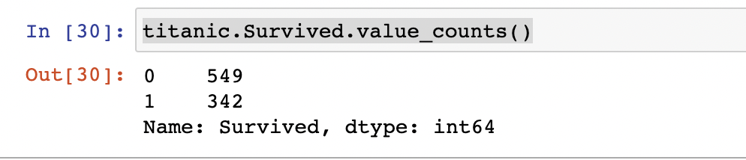
Pandas
Other Useful functions
df[column].value_counts() – returns a frequency count of the column
df[column].value_counts(normalize=True) returns the % of total for the column
df.info() – concise summary of dataframe
df.describe() – provides summary statistics of your DataFrame’s numeric columns
<class 'pandas.core.frame.DataFrame'>
RangeIndex: 3333 entries, 0 to 3332
Data columns (total 21 columns):
state 3333 non-null object
account_length 3333 non-null int64
area_code 3333 non-null int64
phone 3333 non-null object
 | count | mean | std | min | 0.25 | 0.5 | 0.75 | max
account_length | 3333 | 101.064806 | 39.822106 | 1 | 74 | 101 | 127 | 243
area_code | 3333 | 437.182418 | 42.37129 | 408 | 408 | 415 | 510 | 510
vmail_message | 3333 | 8.09901 | 13.688365 | 0 | 0 | 0 | 20 | 51

Slide 34
Pandas
df.query() a better way to filter rows …
Fast & readable queries for filtering rows, can use engine = “python”
Reference columns without quotes
Supports operators BUT concatenate conditions with “and” and “or”
Organize with Parenthesis ()
df.query('area_code == "415" and \
intl_plan == "yes" and \
day_mins < 100 and \
state == ["WI", "OR", "WY"]')
state | area_code | phone | intl_plan | day_calls | state | day_mins | day_charge | eve_calls | eve_charge
WI | 415 | 355-7705 | yes | 92 | WI | 62.3 | 10.59 | 82 | 23.38
OR | 415 | 378-6772 | yes | 67 | OR | 12.5 | 2.13 | 90 | 21.81
WY | 415 | 412-3726 | yes | 117 | WY | 95.9 | 16.3 | 131 | 13.56

Slide 35
Pandas
df.query() by reference
We can refer to variables in the environment by prefixing them with the @ character. This makes it really easy to evaluate complex expressions for example
mean_calls = df['day_calls'].mean()
state_list = ["WI", "OR", "WY"]
df.query('area_code == "415" and \
intl_plan == "yes" and \
day_calls < @mean_calls and \
state == @state_list')
Passing Values to a Query by Reference
state | area_code | phone | intl_plan | day_calls | state | day_mins | day_charge | eve_calls | eve_charge
OR | 415 | 332-9460 | yes | 87 | OR | 176.2 | 29.95 | 81 | 12.33
WI | 415 | 421-9401 | yes | 91 | WI | 264.3 | 44.93 | 115 | 13.68
WI | 415 | 355-7705 | yes | 92 | WI | 62.3 | 10.59 | 82 | 23.38
WY | 415 | 406-1349 | yes | 78 | WY | 189.6 | 32.23 | 117 | 22.73
WI | 415 | 339-6637 | yes | 97 | WI | 126.9 | 21.57 | 102 | 14.19

Slide 36
Pandas
Conditional Operators for Query(expression) based Filtering
Query supports the common operator stuff but now you are writing an EXPRESSION
df.query('expression1 and expression2’)
notice the ‘single’ quote surrounds the expressions!
equal to: df.query('column == “some_value”')
not equal to: df.query('column != “some_value”')
greater than: df.query('column > some_value’) valid:( ==, !=, >, >=, <, <=)
In a list: df.query('column == ["list","value"]')
Not in List: df.query('column != ["list","value"]’)
To find nulls use
df.query('column.isnull()', engine='python' ) note the engine=‘python’ command.
common alternative df.query('column != column', engine='python’ )
To find not null use
df.query('column.notnull()', engine='python' ) note the engine=python command.
common alternative df.query('column == column', engine='python’ )
You can connect Multiple-Conditions with the word and and or
df.query(‘(column != "value1" \
and column2 > 50)\
or column3 == “A”', engine='python' )

Slide 37
Combining Rows and Columns
How do I put my filtering together?
Dataframe based filtering is simple as adding a bracket bracket after the row filter.
rowcol1 = titanic[titanic["Age"] > 50] [["PassengerId", "Survived", "Name", "Age"]]
print(rowcol1["Survived"].value_counts())
Query based filtering is as simple as adding a bracket bracket after the query as well.
rowcol2 = churn.query('State == ["VA", "TX", "TN"] \
and `Account Length` > 100')[["State",
"Account Length",
"Churn?",
"Area Code",
"Phone"]]
print(rowcol2["Churn?"].value_counts())

Slide 38
Open: Day 3.5 Pandas
10 Minutes

Slide 39
Converting a List to a Data Frame
Lists are cool but DataFrames are cooler
Lists: a list is essentially a collection of elements, which could be integers, floats, strings, or even other lists.
Why Convert a List to a DataFrame?
Analysis – pandas makes it easy to filter, summarize and analyze data
Data Manipulation – pandas makes it easy to change, update, sort, join and structure data.
Deal w. Big Data – DataFrames allow us to deal with “big” data
How to Convert a List to a DataFrame, is easy with pd.DataFrame() function.
import pandas as pd
# Example list my_list = [10, 20, 30, 40, 50]
# Convert list to DataFrame
df = pd.DataFrame(my_list, columns=['Numbers']) # Display the DataFrame print(df)

Slide 40
Open: Day 3.6 list to Pandas
10 Minutes

Slide 41
Converting a Dictionary to a Data Frame
Easy
import pandas as pd
# Sample dictionary
data = {
'Name': ['John', 'Emma', 'Peter'],
'Age': [25, 28, 32],
'City': ['New York', 'London', 'Paris']
}
# Convert dictionary to DataFrame
df = pd.DataFrame(data)
# Print the DataFrame
print(df)
To convert a dictionary to a pandas DataFrame, we can use the pd.DataFrame function provided by the pandas library.
The keys of the dictionary will become the column names of the DataFrame, and the corresponding values will populate the columns.
Name Age City
0 John 25 New York
1 Emma 28 London
2 Peter 32 Paris

Slide 42
Open: Day 3 Dictionary to Data Frames
10 Minutes

Slide 43
Dealing w. Nulls
Finding nulls
The isnull() and isna()functions are used to detect missing or null values in a Pandas DataFrame.
It returns a boolean mask, where True indicates a missing value and False indicates a non-missing value.
Syntax: DataFrame.isnull() or DataFrame.isna()
# Creating a DataFrame
data = {'Column1': [1, 2, None, 4, 5],
'Column2': ['a', 'b', 'c', None, 'e']}
df = pd.DataFrame(data)
# Checking for missing values
null_mask = df.isnull()
print(null_mask)
Column1 Column2
0 False False
1 False False
2 True False
3 False True
4 False False

Slide 44
Dealing w. Nulls
Finding nulls ok that’s not helpful
The isnull() and isna()functions are used to detect missing or null values in a Pandas DataFrame.
It returns a boolean mask, where True indicates a missing value and False indicates a non-missing value.
Use sum() to get the count of nulls per column.
Use sum(axis=1) to get a count of nulls per row.
# nulls by column
df.isnull().sum()
Column1 1
Column2 1
# nulls by row
df.isnull().sum(axis=1)
0 0
1 0
2 1
3 1
4 0

Slide 45
Dealing w. Nulls
Filling nulls in
The fillna function in Pandas is used to fill missing or null values in a DataFrame or Series.
It allows you to replace missing values with a specified scalar value, a dictionary mapping columns to values, or by using various filling methods.
Syntax: DataFrame.fillna(value, method, axis, inplace)
The value parameter specifies the value to use for filling missing values.
The method parameter determines the filling method to use (e.g., forward fill, backward fill, interpolation, etc.).
The axis parameter indicates the axis along which the filling operation is performed (0 for rows, 1 for columns).
The inplace parameter specifies whether to modify the DataFrame in place or return a new DataFrame with filled values.

Slide 46
Dealing w. Nulls
Filling nulls in
# Creating a DataFrame
data = {'Column1': [1, None, 3, None, 5],
'Column2': ['a', 'b', None, 'd', 'e']}
df = pd.DataFrame(data)
# Filling missing values with scalar value
df_filled = df.fillna(0)
# Creating a DataFrame
data = {'Column1': [1, None, 3, None, 5],
'Column2': [4, 2, None, 6, None]}
df = pd.DataFrame(data)
# Filling missing values with mean
df_filled = df.fillna(df.mean(), inplace=True)
print(df_filled)

Slide 47
Open: Day 3.6 Nulls
10 Minutes

Slide 48
Dealing w. Dates
Convert string to date.
In Pandas, you can convert a string representation of a date to a proper date format using the to_datetime function.
This conversion allows you to perform date-based operations and analysis on your data.
Syntax: pd.to_datetime(arg, format=None, errors='raise')
The arg parameter represents the input data that needs to be converted.
The format parameter specifies the format of the input string if it is not a standard date format.
The errors parameter determines how errors during conversion are handled.
# Creating a DataFrame
data = {'Date': ['2022-01-01', '2022-02-01', '2022-03-01']}
df = pd.DataFrame(data)
# Converting string to date
df['Date'] = pd.to_datetime(df['Date'])
print(df)

Slide 49
Dealing w. Dates
Filtering dates
You can use the query method to filter dates in a DataFrame based on different criteria, such as date ranges or specific dates.
Key thing to know! The default date format is yyyy-mm-dd and pandas will convert automagically
# Creating a DataFrame with a 'Date' column
data = {'Date': ['2022-01-01', '2022-02-01', '2022-03-01', '2022-04-01']}
df = pd.DataFrame(data)
# Converting 'Date' column to datetime type
df['Date'] = pd.to_datetime(df['Date'])
# Filtering dates using the query method
filtered_df = df.query("'2022-02-01' <= Date <= '2022-03-31'")
print(filtered_df)

Slide 50
Iterating over rows.
Iterrows
In Pandas, you can iterate over rows of a DataFrame using various methods, such as iterrows(), itertuples(), or index-based iteration.
Iterating over rows allows you to access and process individual rows or perform row-wise calculations or transformations.
NOTE: iterating over rows in Pandas IS slower compared to using vectorized operations, which are more EFFICENT (FASTER!)
# Creating a DataFrame
data = {'Name': ['John', 'Alice', 'Bob'],'Age': [25, 30, 35]}
df = pd.DataFrame(data)
# Iterating over rows using iterrows()
for index, row in df.iterrows():
print(f"Row index: {index}")
print(f"Name: {row['Name']}, Age: {row['Age']}")
print("---")

Slide 51


